Slide 1
Yelp Reviews vs Neighborhood Demographic Data
Jimmy Moore

Slide 2
Abstract
The goal of this project is to analyze the effect that neighborhood racial demographics, and by extension city zoning laws and redlining has had on online reviews. In particular this project will focus on the online review site, Yelp, as well as the city of Philadelphia.

Slide 3
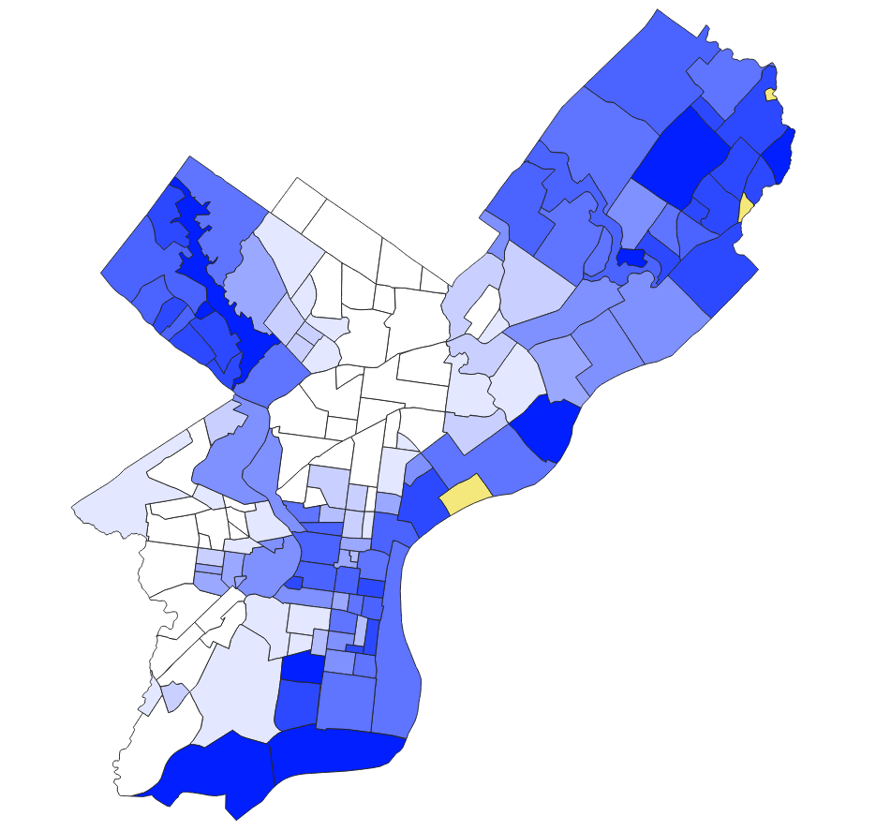
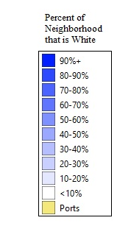
Why Philadelphia?
While this project could, and should be applied to any given city, Philadelphia was chosen as the test case for three main reasons
It is a very large sample size
It is one of the most segregated cities in America
It incorporates its suburbs as cities neighborhoods

Slide 4
Data Collection
Review data was collected from Yelp in late March of 2023, neighborhood data was collected with the help of the OpenPhillyData project, and racial demographic data was obtained via available census records

Slide 5
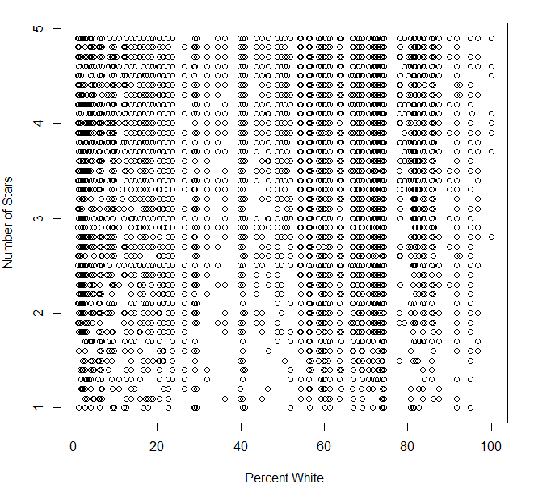
Initial Plotting
The initial plot seems random, without any major distinguishable patterns, however there are obvious concentration bands around 2% and 75% that demonstrate the deep divisions within the city

Slide 6
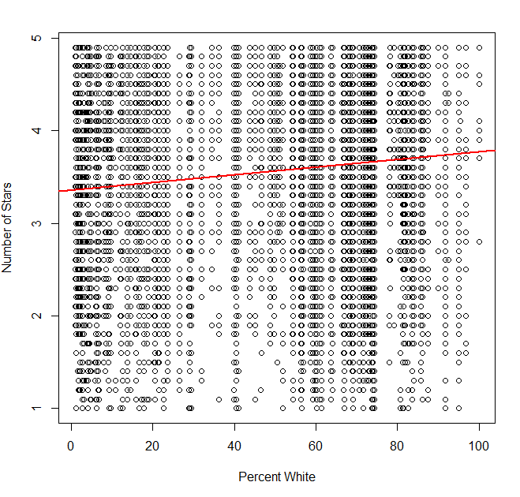

Hidden Patterns
However, a computer’s analysis of this seemingly random data reveals a startlingly apparent line showing direct correlation. This line has a p-value of less than 0.0001, implying a very strong correlation.
And while the slope may seem very gradual, there is on average a nearly half star difference in average reviews between the neighborhoods, a difference that could prevent an establishment from getting featured

Slide 7
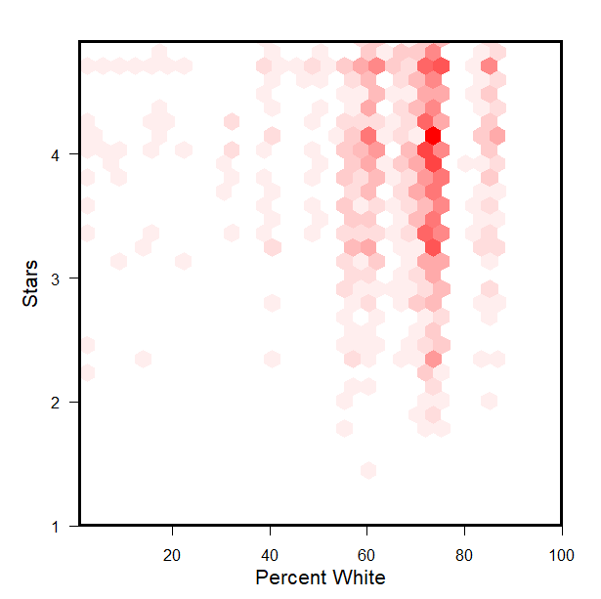
A Different View
To better understand why the data behaves the way it does, a hexbin plot can help.
We can now see the various intensities of both how segregated the city is, and the concentration of high star reviews in whiter neighborhoods

Slide 8
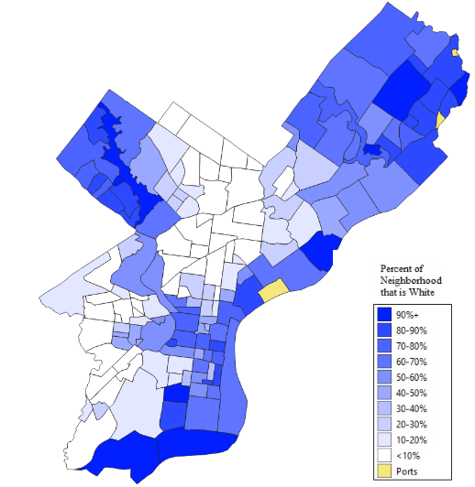
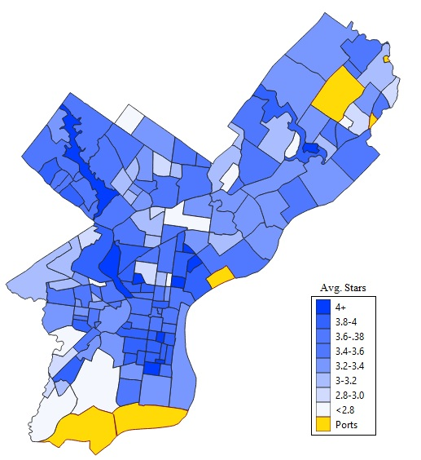
Neighborhoods and Stars

Slide 9
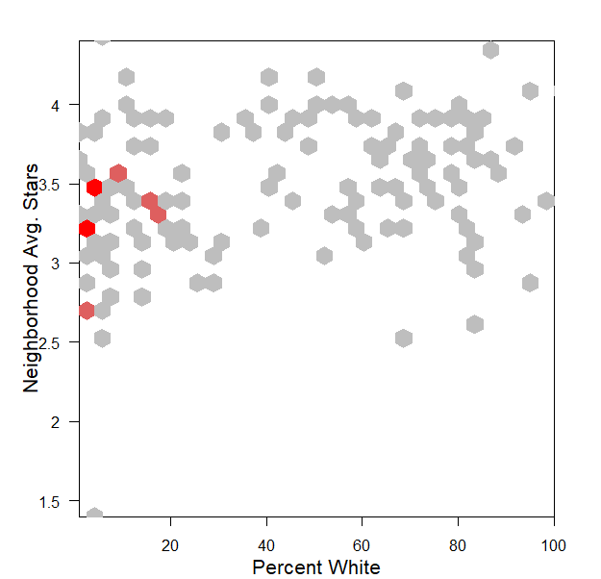
Neighborhood Hexbin
Its harder to see, from the previous graphs but Philadelphia actually has more neighborhoods that are not majority white

Slide 10
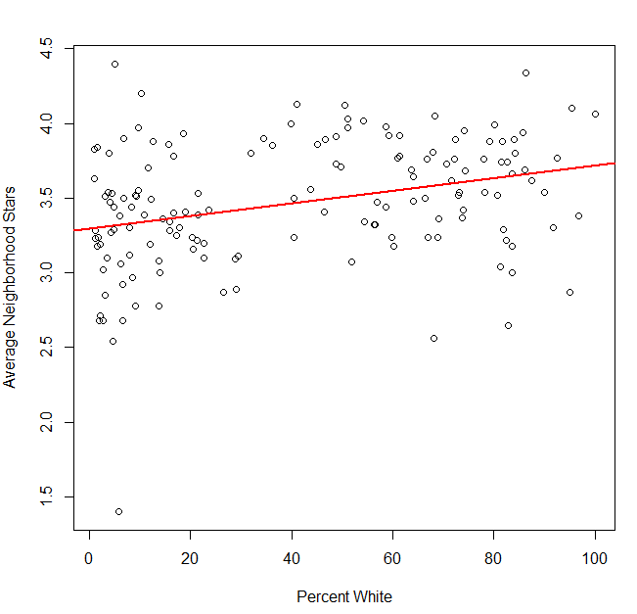

Neighborhoods and Stars Con.
While visible in the maps, this trend is reinforced when we look at just neighborhoods and their average reviews. The correlation p value is just as strong (<0.0001), but the slope has become more gentle, only about a 0.4 star difference between the whitest and least white neighborhood.
The difference in slopes from the original model can be attributed to this model being less affected by population density

Slide 11
Implications
Unfortunately it does appear that there is a distinct correlation between the whiteness of a neighborhood and the average reviews that establishments in it receive
This means that business owners from less white neighborhoods are getting lower reviews and are therefore being featured less on Yelp, coming up lower in search results, and generally being chosen less from a customer base.
It also means that redlining practices are still permeating this part of American life and preventing citizens from fully and freely engaging in the economic process

Slide 12
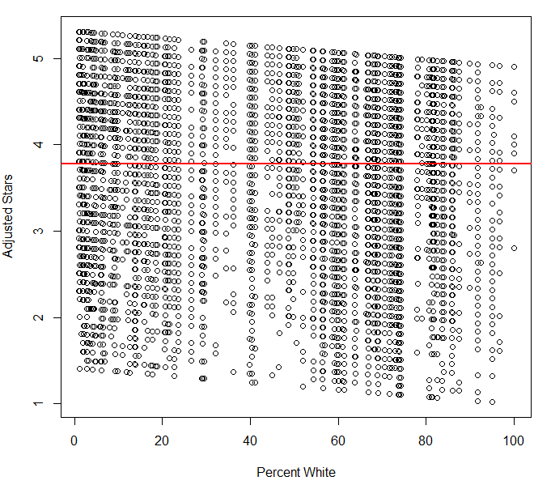

Possible Solutions
By adding a dynamic “stability coefficient” we can actually affect the data in a way such that we eliminate the bias of racial demographics. (The stability coefficient is just adding the inverse of the slope)
As we can see this data has a slope of 0 and is entirely random in its distribution. We also have a fairly reasonable intercept of 3.77, meaning the average business gets roughly a 75%, or a C grade.
However, this graph has an obvious visual slope that would, make it impossible to implement as while this model is more fair, it looks like it has a bias.

